Slide 1

PROBLEM STATEMENT : AI-Powered Auto-Reply Chatbot
For Conversation
Name of participants:
yash A Zade
Qaanit Umar
Ganesh Nandane
Vaibhav Chumbalkar
Rohit Abgad
Paras Agbattanwar

Slide 2
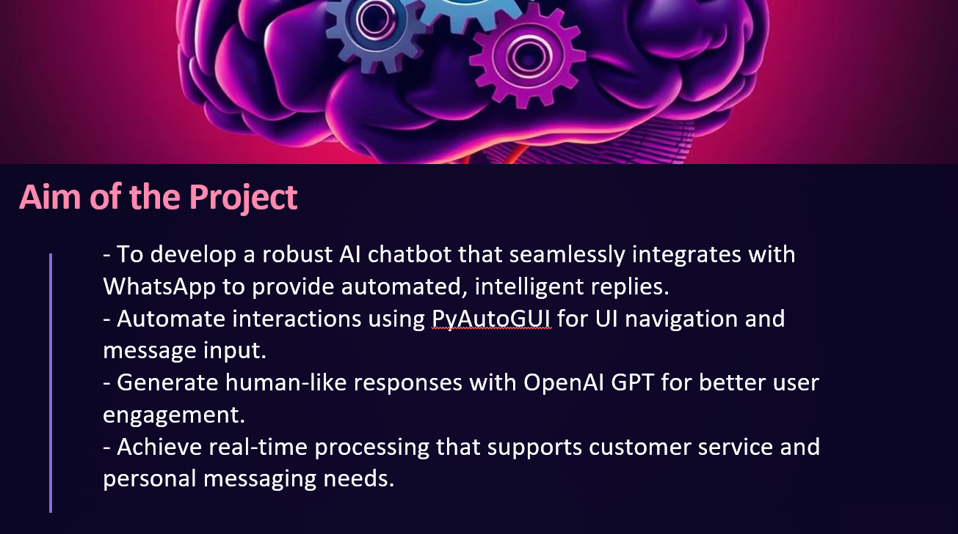
Problem Statement: AI-Powered Auto-Reply Chatbot
Many businesses face delays in responding to customer queries, especially during busy hours, leading to customer frustration. Additionally, human agents can be inconsistent, expensive, and unavailable 24/7. There's a need for an AI-powered chatbot that can provide instant, accurate, and consistent responses, handle a large volume of inquiries, and offer round-the-clock support without the need for extra human resources.

Slide 3
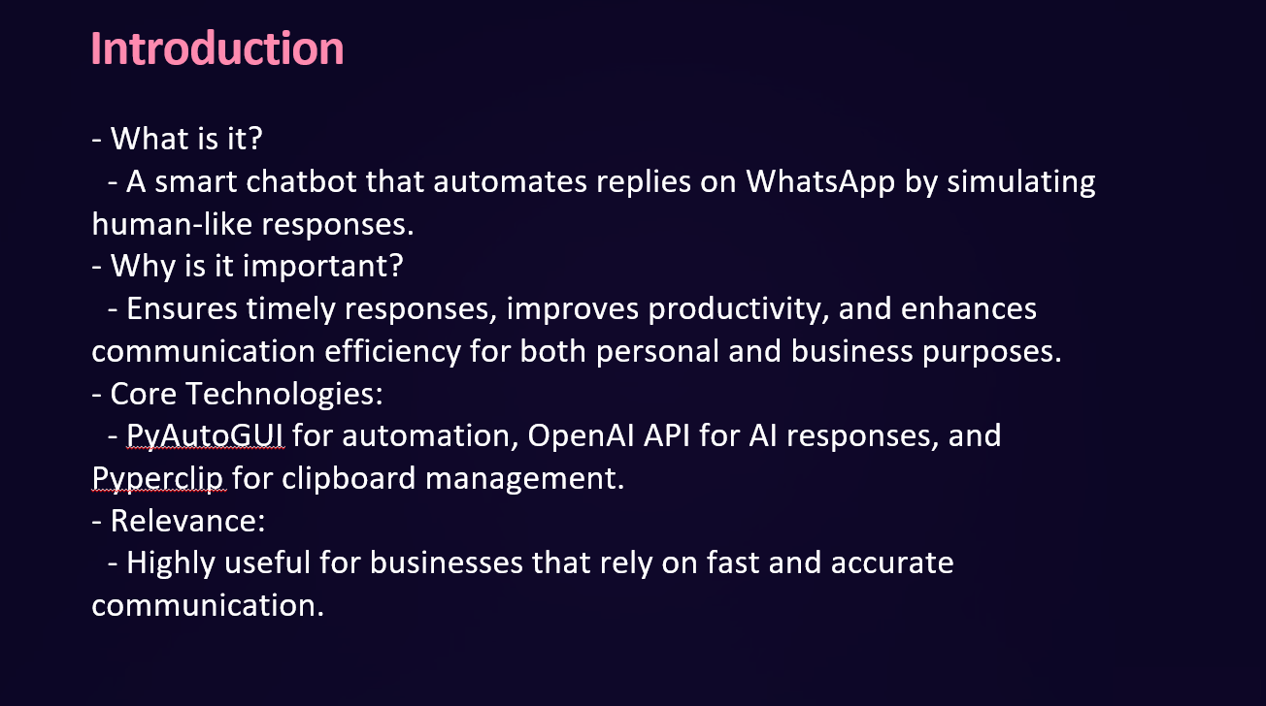

Slide 4




02
03
01
04
2️⃣ PyAutoGUI – Automates Mouse and Keyboard Interactions
PyAutoGUI is a Python library that allows GUI automation, which means it can control the keyboard and mouse to interact with applications like WhatsApp Web.
✅ How PyAutoGUI is used in this project?
Click on the WhatsApp Web icon to open the chat window
Move and drag the cursor to select chat messages
Copy and paste text messages for processing
Press Enter key to send AI-generated replies
✅ Why PyAutoGUI?
Provides direct control over screen interactions
Can be used for automating UI tasks without API limitations
Works on multiple operating systems
3️⃣ Pyperclip – Clipboard Operations (Copy-Paste Messages)
Pyperclip is a Python library that enables clipboard interactions. It is used to copy the chat history from WhatsApp Web and paste the AI-generated response into the chatbox.
✅ How Pyperclip is used in this project?
Copies chat history from WhatsApp Web after selecting messages
Stores the copied text in Python for AI processing
Pastes the AI-generated reply into the WhatsApp chatbox
✅ Why Pyperclip?
Allows seamless copy-paste operations
Works across different platforms (Windows, macOS, Linux)
No need for additional dependencies
1️⃣ Python – Main Programming Language
Python is used as the core language for this project because of its simplicity, extensive library support, and ease of automation. The chatbot script is written in Python to interact with WhatsApp Web, process messages, and generate automated replies using AI.
✅ Why Python?
Easy to use and write automation scripts
Large number of third-party libraries (e.g., PyAutoGUI, Pyperclip, OpenAI API)
Great support for AI and automation tasks
1️⃣ Python – Main Programming Language
Python is used as the core language for this project because of its simplicity, extensive library support, and ease of automation. The chatbot script is written in Python to interact with WhatsApp Web, process messages, and generate automated replies using AI.
✅ Why Python?
Easy to use and write automation scripts
Large number of third-party libraries (e.g., PyAutoGUI, Pyperclip, OpenAI API)
Great support for AI and automation tasks
Technologies
Used

Slide 5
03
02
01
04
2️⃣ PyAutoGUI – Automates Mouse and Keyboard Interactions
PyAutoGUI is a Python library that allows GUI automation, which means it can control the keyboard and mouse to interact with applications like WhatsApp Web.
✅ How PyAutoGUI is used in this project?
Click on the WhatsApp Web icon to open the chat window
Move and drag the cursor to select chat messages
Copy and paste text messages for processing
Press Enter key to send AI-generated replies
✅ Why PyAutoGUI?
Provides direct control over screen interactions
Can be used for automating UI tasks without API limitations
Works on multiple operating systems
1️⃣ Python – Main Programming Language
Python is used as the core language for this project because of its simplicity, extensive library support, and ease of automation. The chatbot script is written in Python to interact with WhatsApp Web, process messages, and generate automated replies using AI.
✅ Why Python?
Easy to use and write automation scripts
Large number of third-party libraries (e.g., PyAutoGUI, Pyperclip, OpenAI API)
Great support for AI and automation tasks
3️⃣ Pyperclip – Clipboard Operations (Copy-Paste Messages)
Pyperclip is a Python library that enables clipboard interactions. It is used to copy the chat history from WhatsApp Web and paste the AI-generated response into the chatbox.
✅ How Pyperclip is used in this project?
Copies chat history from WhatsApp Web after selecting messages
Stores the copied text in Python for AI processing
Pastes the AI-generated reply into the WhatsApp chatbox
✅ Why Pyperclip?
Allows seamless copy-paste operations
Works across different platforms (Windows, macOS, Linux)
No need for additional dependencies
1️⃣ Python – Main Programming Language
Python is used as the core language for this project because of its simplicity, extensive library support, and ease of automation. The chatbot script is written in Python to interact with WhatsApp Web, process messages, and generate automated replies using AI.
✅ Why Python?
Easy to use and write automation scripts
Large number of third-party libraries (e.g., PyAutoGUI, Pyperclip, OpenAI API)
Great support for AI and automation tasks
Technologies
Used
1

Slide 6
02
03
01
04
2️⃣ PyAutoGUI – Automates Mouse and Keyboard Interactions
PyAutoGUI is a Python library that allows GUI automation, which means it can control the keyboard and mouse to interact with applications like WhatsApp Web.
✅ How PyAutoGUI is used in this project?
Click on the WhatsApp Web icon to open the chat window
Move and drag the cursor to select chat messages
Copy and paste text messages for processing
Press Enter key to send AI-generated replies
✅ Why PyAutoGUI?
Provides direct control over screen interactions
Can be used for automating UI tasks without API limitations
Works on multiple operating systems
3️⃣ Pyperclip – Clipboard Operations (Copy-Paste Messages)
Pyperclip is a Python library that enables clipboard interactions. It is used to copy the chat history from WhatsApp Web and paste the AI-generated response into the chatbox.
✅ How Pyperclip is used in this project?
Copies chat history from WhatsApp Web after selecting messages
Stores the copied text in Python for AI processing
Pastes the AI-generated reply into the WhatsApp chatbox
✅ Why Pyperclip?
Allows seamless copy-paste operations
Works across different platforms (Windows, macOS, Linux)
No need for additional dependencies
1️⃣ Python – Main Programming Language
Python is used as the core language for this project because of its simplicity, extensive library support, and ease of automation. The chatbot script is written in Python to interact with WhatsApp Web, process messages, and generate automated replies using AI.
✅ Why Python?
Easy to use and write automation scripts
Large number of third-party libraries (e.g., PyAutoGUI, Pyperclip, OpenAI API)
Great support for AI and automation tasks
1️⃣ Python – Main Programming Language
Python is used as the core language for this project because of its simplicity, extensive library support, and ease of automation. The chatbot script is written in Python to interact with WhatsApp Web, process messages, and generate automated replies using AI.
✅ Why Python?
Easy to use and write automation scripts
Large number of third-party libraries (e.g., PyAutoGUI, Pyperclip, OpenAI API)
Great support for AI and automation tasks
Technologies
Used
1

Slide 7
02
03
01
04
2️⃣ PyAutoGUI – Automates Mouse and Keyboard Interactions
PyAutoGUI is a Python library that allows GUI automation, which means it can control the keyboard and mouse to interact with applications like WhatsApp Web.
✅ How PyAutoGUI is used in this project?
Click on the WhatsApp Web icon to open the chat window
Move and drag the cursor to select chat messages
Copy and paste text messages for processing
Press Enter key to send AI-generated replies
✅ Why PyAutoGUI?
Provides direct control over screen interactions
Can be used for automating UI tasks without API limitations
Works on multiple operating systems
1️⃣ Python – Main Programming Language
Python is used as the core language for this project because of its simplicity, extensive library support, and ease of automation. The chatbot script is written in Python to interact with WhatsApp Web, process messages, and generate automated replies using AI.
✅ Why Python?
Easy to use and write automation scripts
Large number of third-party libraries (e.g., PyAutoGUI, Pyperclip, OpenAI API)
Great support for AI and automation tasks
3️⃣ Pyperclip – Clipboard Operations (Copy-Paste Messages)
Pyperclip is a Python library that enables clipboard interactions. It is used to copy the chat history from WhatsApp Web and paste the AI-generated response into the chatbox.
✅ How Pyperclip is used in this project?
Copies chat history from WhatsApp Web after selecting messages
Stores the copied text in Python for AI processing
Pastes the AI-generated reply into the WhatsApp chatbox
✅ Why Pyperclip?
Allows seamless copy-paste operations
Works across different platforms (Windows, macOS, Linux)
No need for additional dependencies
1️⃣ Python – Main Programming Language
Python is used as the core language for this project because of its simplicity, extensive library support, and ease of automation. The chatbot script is written in Python to interact with WhatsApp Web, process messages, and generate automated replies using AI.
✅ Why Python?
Easy to use and write automation scripts
Large number of third-party libraries (e.g., PyAutoGUI, Pyperclip, OpenAI API)
Great support for AI and automation tasks
Technologies
Used
1

Slide 8
02
03
01
04
4️⃣ OpenAI API – Generates AI-Based Replies
The OpenAI API is used to process the chat history and generate a smart response. The chatbot sends the copied chat history to OpenAI’s GPT-3.5-turbo model, which then analyzes the context and provides a relevant response.
✅ How OpenAI API is used in this project?
Reads the latest messages from the chat history
Understands the conversation context
Generates an AI-powered response (e.g., funny roast, informative reply)
Sends the reply back to WhatsApp using PyAutoGUI
✅ Why OpenAI API?
Generates human-like conversations
Can understand and analyze chat context
Supports both Hindi and English for multilingual replies
2️⃣ PyAutoGUI – Automates Mouse and Keyboard Interactions
PyAutoGUI is a Python library that allows GUI automation, which means it can control the keyboard and mouse to interact with applications like WhatsApp Web.
✅ How PyAutoGUI is used in this project?
Click on the WhatsApp Web icon to open the chat window
Move and drag the cursor to select chat messages
Copy and paste text messages for processing
Press Enter key to send AI-generated replies
✅ Why PyAutoGUI?
Provides direct control over screen interactions
Can be used for automating UI tasks without API limitations
Works on multiple operating systems
1️⃣ Python – Main Programming Language
Python is used as the core language for this project because of its simplicity, extensive library support, and ease of automation. The chatbot script is written in Python to interact with WhatsApp Web, process messages, and generate automated replies using AI.
✅ Why Python?
Easy to use and write automation scripts
Large number of third-party libraries (e.g., PyAutoGUI, Pyperclip, OpenAI API)
Great support for AI and automation tasks
3️⃣ Pyperclip – Clipboard Operations (Copy-Paste Messages)
Pyperclip is a Python library that enables clipboard interactions. It is used to copy the chat history from WhatsApp Web and paste the AI-generated response into the chatbox.
✅ How Pyperclip is used in this project?
Copies chat history from WhatsApp Web after selecting messages
Stores the copied text in Python for AI processing
Pastes the AI-generated reply into the WhatsApp chatbox
✅ Why Pyperclip?
Allows seamless copy-paste operations
Works across different platforms (Windows, macOS, Linux)
No need for additional dependencies
Technologies
Used
1

Slide 10
03.PROCESS
Send the message content to the OpenAI API for response generation.
Workflow of the
Chatbot
04.GENERATE
Retrieve AI-generated replies from OpenAI and prepare them for sending.
02.COPY
Select and copy recent chat messages using PyAutoGUI and Pyperclip.
05.PASTE
Paste the reply into the chat box.
01.DETECT
Monitor WhatsApp Web for new messages using pixel detection and predefined coordinates.
06.SEND
Send it, automating the entire conversation flow

Slide 11
Mouse Position Tracker
01
AI chat processing
Detects chat box and message area
Uses Open AI
04
04
Code Implementation Overview
02
Chat Extraction
Automated Reply
Selects and Copies Messages
Pastes and Sends
03
S

Slide 12
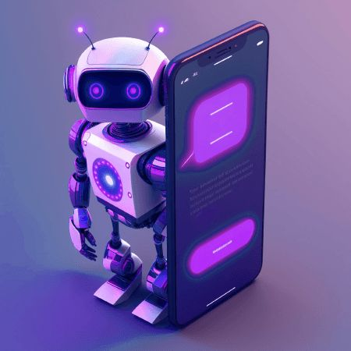
Automated Chatbot with
PyAutoGUI & OpenAI
A step-by-step breakdown
of the Python script
Notes:
We'll now dive into the Python script itself. I'll break down the code step-by-step. We'll see how PyAutoGUI and OpenAI work together. The goal is to make it easy to understand how the chatbot works.

Slide 13
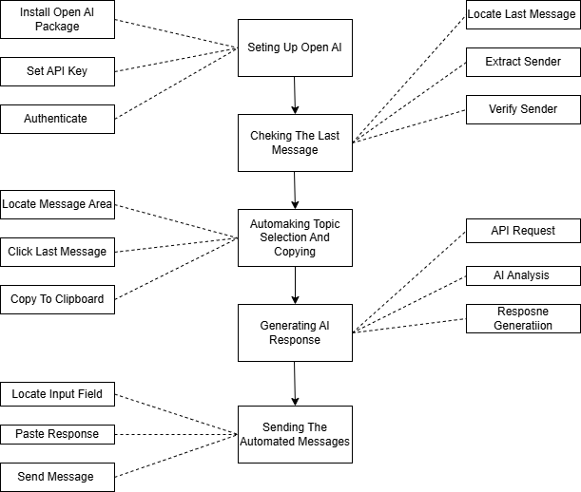
Flow Chart:-

Slide 14
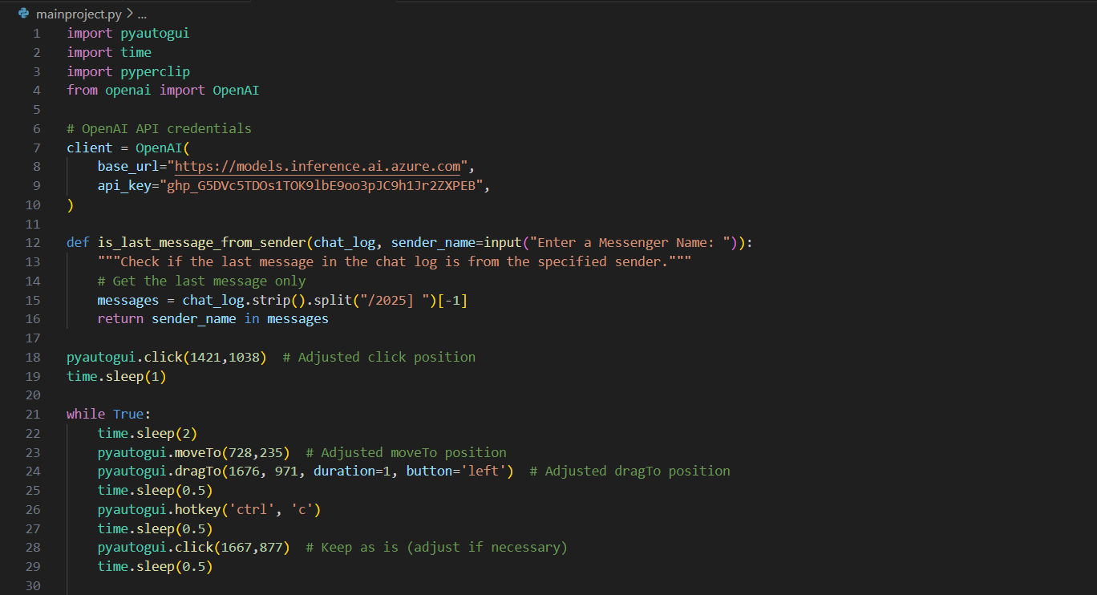

Slide 15
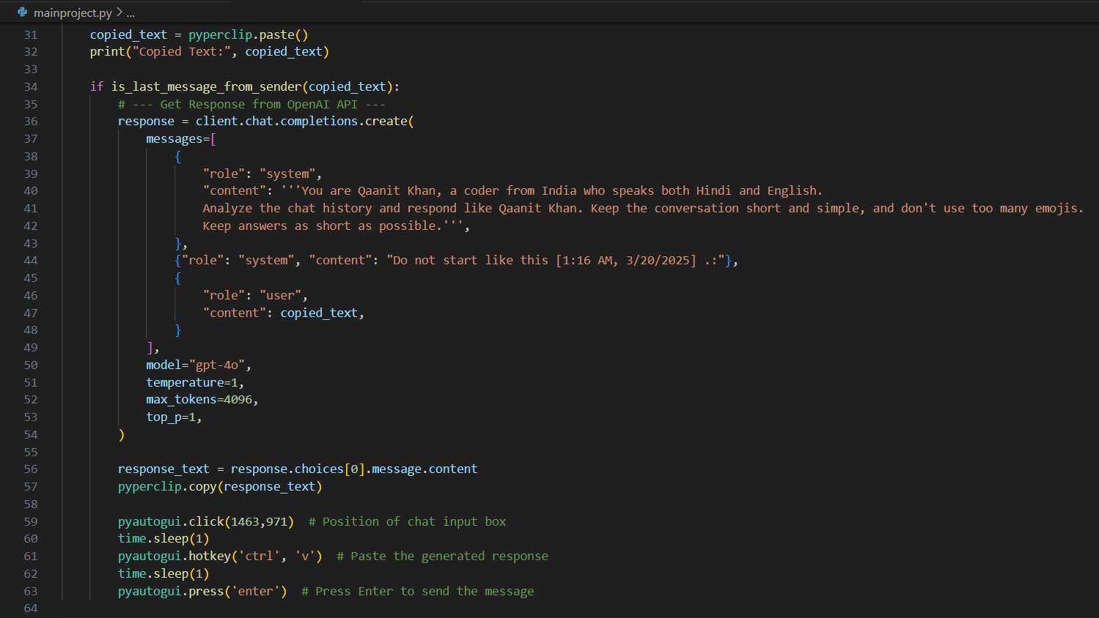

Slide 16
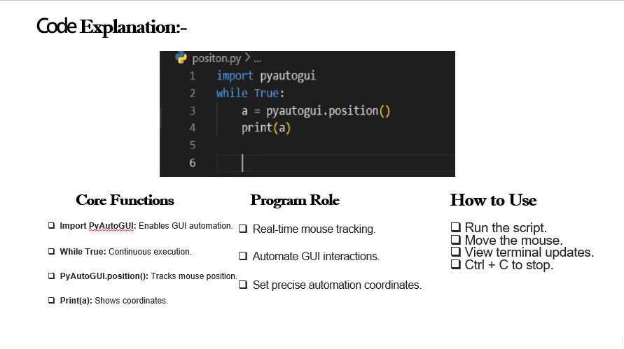
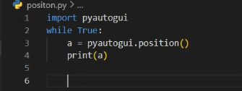
Code Explanation:-
Core Functions
Program Role
How to Use
Import PyAutoGUI: Enables GUI automation.
Real-time mouse tracking.
Run the script.
Move the mouse.
While True: Continuous execution.
Automate GUI interactions.
View terminal updates.
Ctrl + C to stop.
PyAutoGUI.position(): Tracks mouse position.
Set precise automation coordinates.
Print(a): Shows coordinates.

Slide 17
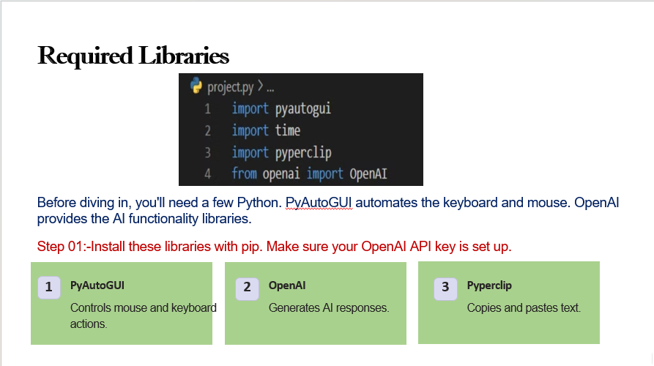
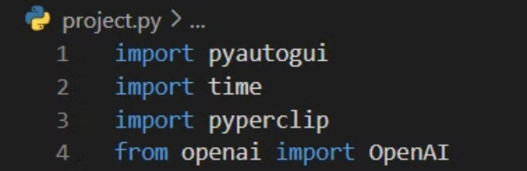
Required Libraries
Before diving in, you'll need a few Python libraries. PyAutoGUI automates the keyboard and mouse. OpenAI provides the AI functionality.
Step 01:-Install these libraries with pip. Make sure your OpenAI API key is set up.
1
PyAutoGUI
2
OpenAI
3
Pyperclip
Controls mouse and keyboard actions.
Generates AI responses.
Copies and pastes text.

Slide 18
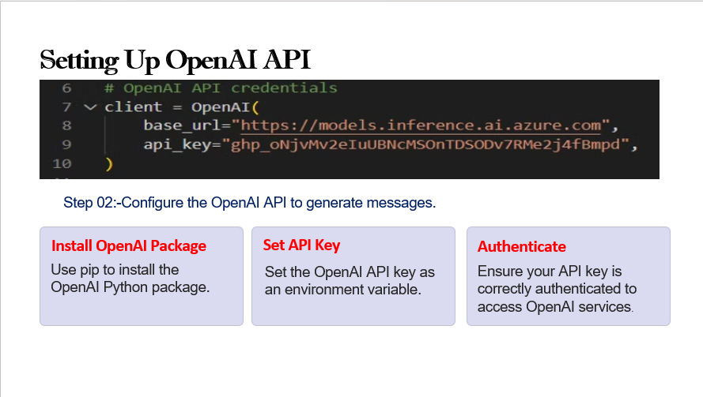
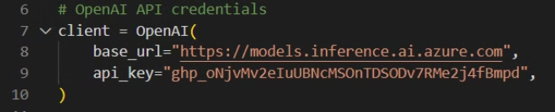
Setting Up OpenAI API
Step 02:-Configure the OpenAI API to generate messages.
Install OpenAI Package
Set API Key
Authenticate
Use pip to install the OpenAI Python package.
Set the OpenAI API key as an environment variable.
Ensure your API key is correctly authenticated to access OpenAI services.

Slide 19
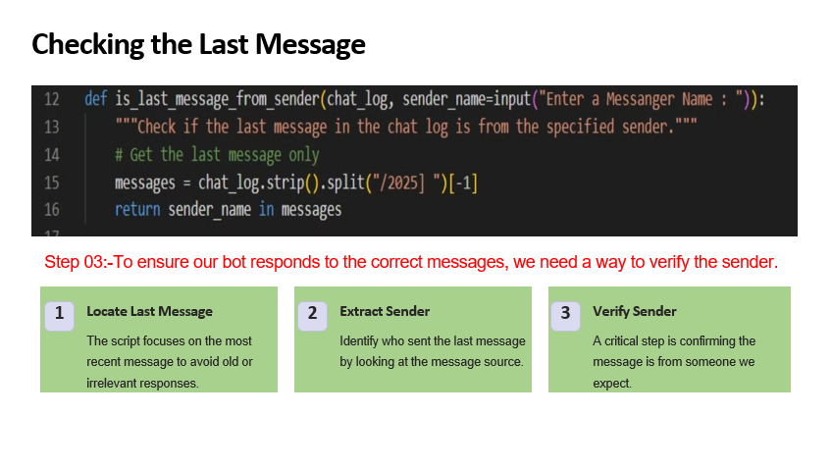
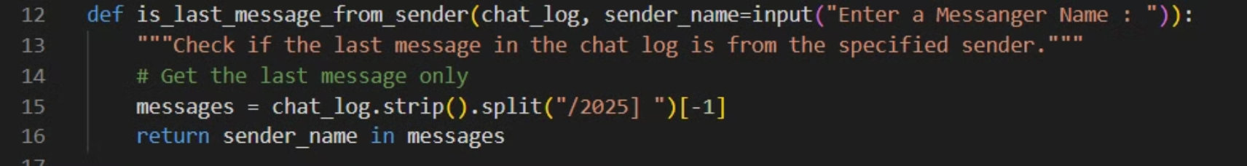
Checking the Last Message
Step 03:-To ensure our bot responds to the correct messages, we need a way to verify the sender.
1
Locate Last Message
2
Extract Sender
3
Verify Sender
The script focuses on the most recent message to avoid old or irrelevant responses.
Identify who sent the last message by looking at the message source.
A critical step is confirming the message is from someone we expect.

Slide 20
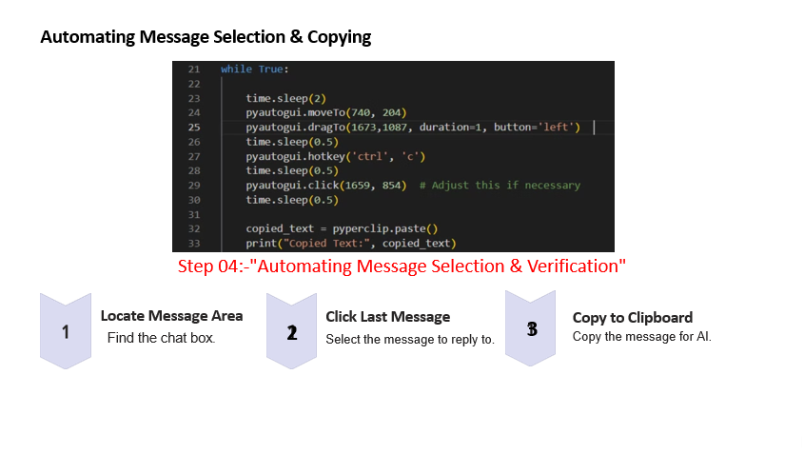
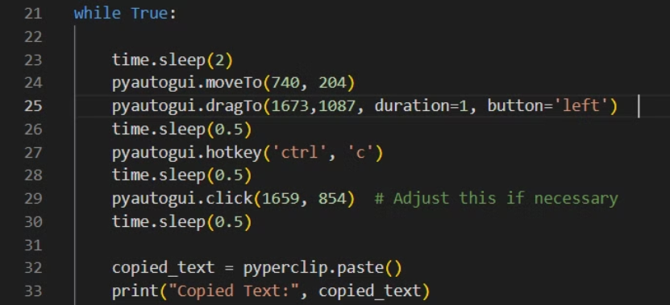

Automating Message Selection & Copying
Step 04:-"Automating Message Selection & Verification"
Locate Message Area
2
Click Last Message
3
Copy to Clipboard
Find the chat box.
Copy the message for AI.
Select the message to reply to.

Slide 21
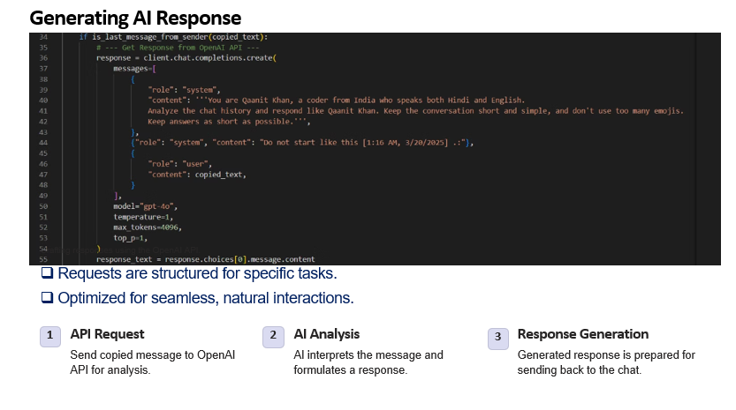
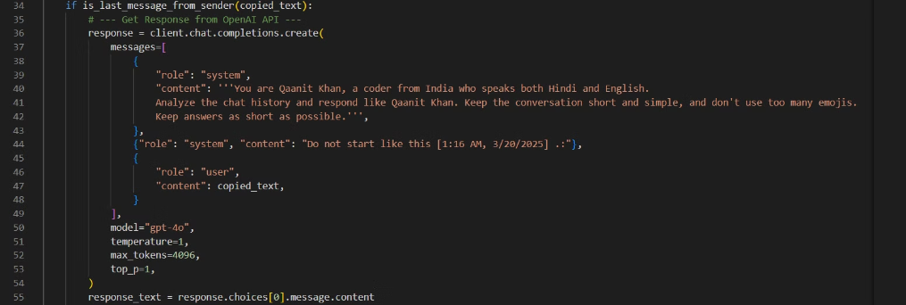
Generating AI Response
Crafting responses using the OpenAI API.
Requests are structured for specific tasks.
Optimized for seamless, natural interactions.
1
API Request
2
AI Analysis
3
Response Generation
Send copied message to OpenAI API for analysis.
AI interprets the message and formulates a response.
Generated response is prepared for sending back to the chat.

Slide 22
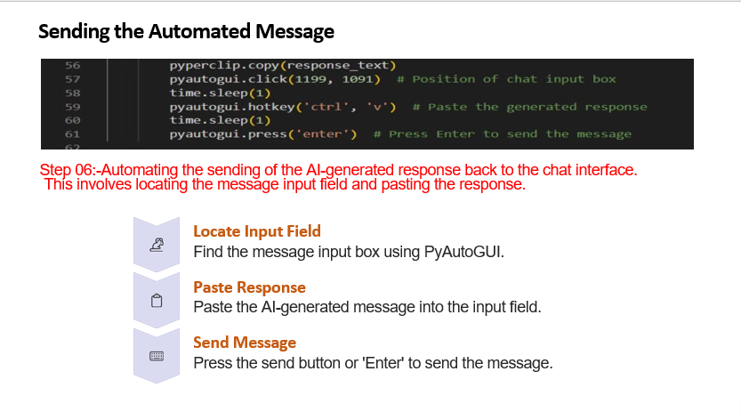
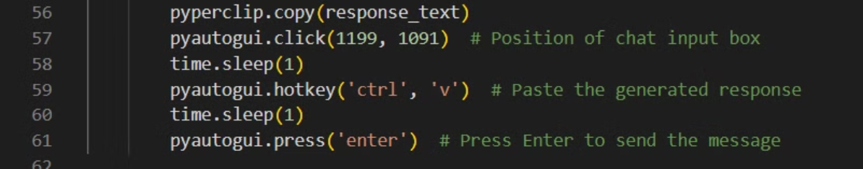



Sending the Automated Message
Step 06:-Automating the sending of the AI-generated response back to the chat interface.
This involves locating the message input field and pasting the response.
Locate Input Field
Find the message input box using PyAutoGUI.
Paste Response
Paste the AI-generated message into the input field.
Send Message
Press the send button or 'Enter' to send the message.

Slide 23
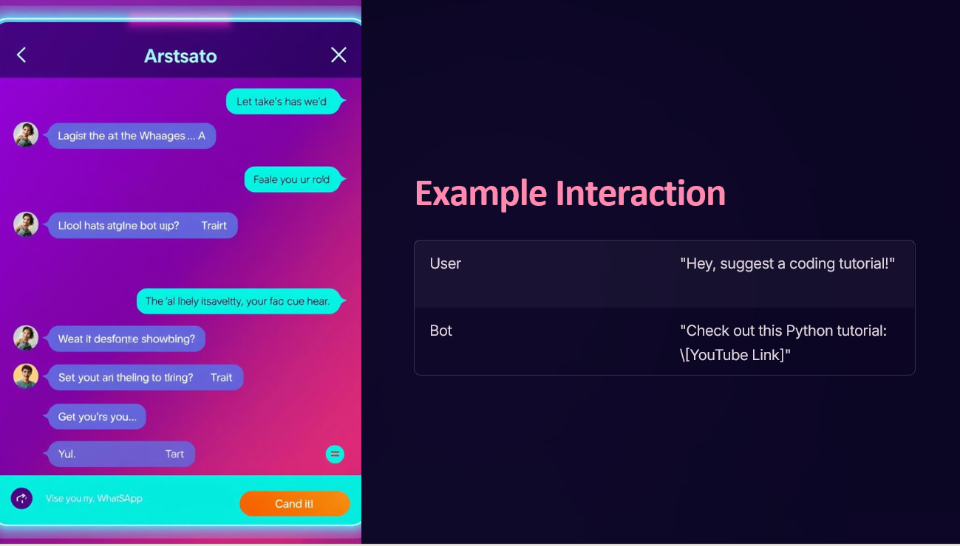

Slide 24

Applications & Use Cases
Customer Support Bots
Automated Responses
WhatsApp AI Assistants
Smart chat Interaction
Fun AI Conversations
Meme generators,etc.
Personal Auto-Replies
Responding when Busy

Slide 25
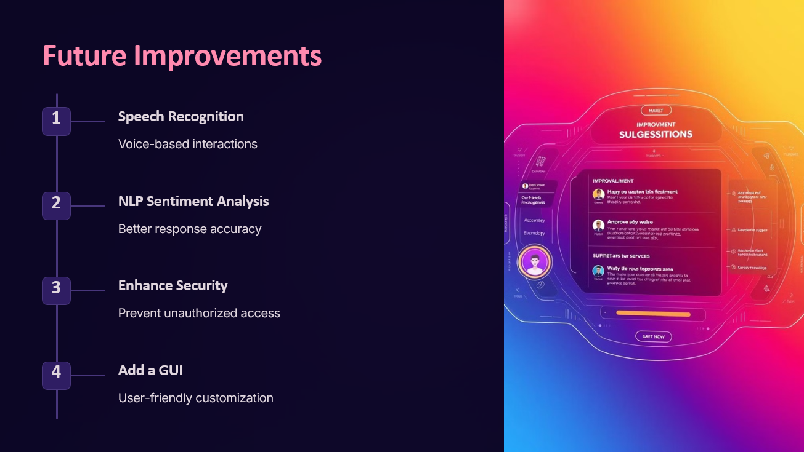

Slide 26
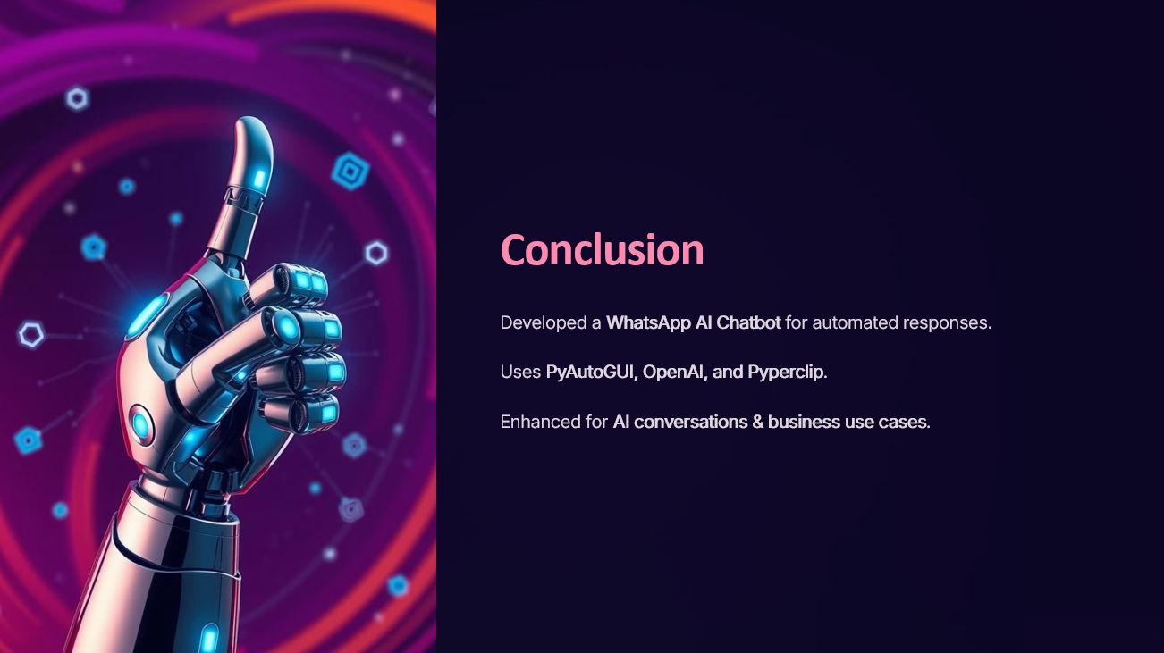

Slide 27


